Slide 1

Prompt-Driven Development
Moving from Stochastic Code Patching
to Deterministic Synthesis & Verification
Greg Tanaka
Founder, PromptDriven.AI
GSL Talk Series • February 10, 2026

Slide 2
Why Are We Still Patching?
1950s
2025
Wool socks cost real money.
Darning made sense.
AI makes each patch faster.
But patches still accumulate.
When socks got cheap enough...
she stopped.
Code just got that cheap.
So why are we still patching?

Slide 3
Part I
The Economics of Darning
What the research actually says about AI-assisted coding

Slide 4
The Greenfield Illusion
55%
0%
faster on individual tasks
throughput change over one year
GitHub, 2022 • 95 devs • one greenfield task
Uplevel, 2024 • 785 devs • real enterprise work
+41% more bugs in enterprise work. "People are ending up being more reviewers... you might have some false faith that the code is doing what you expect."

Slide 5
The 39-Point Perception Gap
PERCEPTION
REALITY
DISCONNECT
+20%
−19%
39pt
Developers believed
AI saved them
AI actually made
them slower
Gap between felt
and measured
METR, 2025 — Experienced open-source developers on mature repositories

Slide 6
The Quality & Churn Data
+44%
Code churn
−60%
Refactoring
New code revised within 2 weeks
Developers stopped cleaning up
GitClear, 211M lines
GitClear, 2025
1.7×
More issues
8×
Perf problems
In AI-generated code vs human
Performance issues in AI code
CodeRabbit, 2025
CodeRabbit, 2025

Slide 7
Context Rot
Even when models retrieve the right information, performance degrades
Small Codebase
Large Codebase
Context window covers ~80%
of the codebase
Context window covers ~2%
Model must guess what's relevant
AI coding tools are
genuinely transformative
Experienced devs 19%
slower with AI tools
55% speedup measured
METR, 2025 — mature repos
Every patch makes the codebase bigger — pushing you from the world where AI helps into the world where it doesn't.

Slide 8



Why Context Length Alone Hurts
Even with perfect retrieval, performance degrades 14–85% from sheer context length. The extra tokens themselves hurt the model's ability to reason.
Lost in the Middle
Mid-context information is systematically underweighted by attention mechanisms
18 Models Confirmed
Pattern holds across all state-of-the-art models tested — not a model-specific flaw
Faster Patching = Faster Rot
AI-accelerated patching grows the codebase faster, accelerating the degradation

Slide 9
The Maintenance Reality
$1.52T
Annual US cost of
poor software quality
CISQ, 2022
+40%
Maintenance cost with
high technical debt
McKinsey, 2024
42%
Developer time spent
on debt & bad code
Stripe, 2018
Technical debt follows compound interest: Debt × (1 + Rate)^Time. Regeneration resets the debt.

Slide 10
Part II
The Paradigm Shift
From schematics to Verilog — and now from code to prompts

Slide 11
The Abstraction Staircase
Every time component counts exceeded what the current abstraction could handle, the industry moved up.
Natural Language
→
2020s
Behavioral / HLS
→
2000s
RTL / Verilog
→
1985–90s
Schematics
→
1970–80s
Transistors
1960s
"Couldn't scale" drives each transition — the designer stops specifying HOW and starts specifying WHAT

Slide 12
Synthesis Was Non-Deterministic Too
Gate netlist #1
Verilog RTL
→
different gates ✓
Formal
Verification
always @(posedge clk)
if (rst) q <= 0;
else q <= d;
⟹
Gate netlist #2
→
SAT/SMT proof:
All outputs are
functionally
equivalent
different gates ✓
→
Gate netlist #3
different gates ✓
The chip industry solved non-deterministic generation by wrapping a verification toolchain around the generator. Same stochastic output problem. Same mathematical solution.
By 1995, half of chip designs used HDL. Today, all but the most trivial chips use synthesis.
ST Micro: 90% of digital IP starts at behavioral level. (Accellera, 2010)

Slide 13
Where Value Lives
CRAFTING (Traditional Dev)
MOLDING (PDD)
Each codebase is hand-written, unique
Prompt + tests define behavior
Bug fixes mean surgical edits
Bugs add test walls, regenerate
Code accumulates patches & workarounds
Code regenerates clean every time
Value lives in the code
Value lives in the prompt & tests
Losing the codebase = losing everything
Code is disposable — regenerate at will
The prompt encodes intent. The tests preserve behavior. Code is just what comes out.

Slide 14
Prompt Space vs Code Space
The fundamental technical advantages of working in natural language
5–10×
30×
0%
More Compact
Model's Native Language
Retrieval Guessing
A prompt is 1/5 to 1/10 the size of the code it governs. Where raw code overwhelms the context window, prompts for 10 modules fit comfortably.
LLMs are trained on up to 30× more natural language than code. NL context boosts coding accuracy by 89% (MIT, ICLR 2024). NL comments alone improve generation 41% (ACL 2024).
Each prompt declares its own dependencies. No embedding search, no agentic file crawling, no context rot. The developer defines what the model sees — not a retrieval system.
Prompts are smaller, in the model's strongest modality, and self-contained. These advantages compound.

Slide 15
Part III
The Mold Has Three Parts
Test capital, prompt capital, and grounding capital

Slide 16



Three Types of Capital
Test Capital
Prompt Capital
Grounding Capital
The Walls
The Specification
The Material
Behavioral constraints that generated code cannot violate. Each bug adds a permanent wall.
Intent, requirements, and contracts. What you want and why. 1/5 to 1/10 the size of code.
Implementation patterns from past successful generations. Style, conventions, structure.

Slide 17
Test Capital: The Walls
TEST: null input → None
Key Finding
TEST: empty string → ""
AI without strong tests
increases instability.
AI with strong tests
amplifies delivery.
TEST: handles unicode ✓
[ generated code fills this space ]
Google DORA, 2025
TEST: latency < 100ms for 10k items
Tests are specification, not just verification. The LLM sees them as constraints during generation.

Slide 18
The Ratchet Effect
TRADITIONAL BUG FIX
PDD BUG FIX
Bug discovered
Bug discovered
→ Hand-carve fix into code
→ Add failing test (add wall)
→ Hope you carved correctly
→ Regenerate code
→ Hope you didn't break anything
→ New code conforms to wall
→ Similar bug appears elsewhere
→ Bug can NEVER recur
→ Patch again...
→ Wall is permanent
Tests only accumulate. The mold only gets more precise. Each wall constrains all future generations.

Slide 19
Formal Verification: Same Math
Hardware: Synopsys Formality
Software: PDD + Z3
SMT solver proves:
RTL ≡ gates
for all possible inputs
Mathematical proof,
not sampling
SMT solver proves:
code satisfies spec
for all possible inputs
Same math,
same certainty
The chip design analogy isn't a metaphor — it's the same technology. Z3 (Microsoft Research) provides the same class of SMT solver used in billion-dollar tapeouts.

Slide 20
Prompt Capital: The Specification
user_parser.prompt
1:5 to 1:10 ratio
% Role: Expert Python engineer
% Scope: Parse user IDs from untrusted input
Requirements:
1) parseUserId(input) → str | None
2) Accept "user:abc123" → "abc123"
3) null/non-string → None, never throw
4) Trim whitespace; reject blank
5) O(n) in input length
6) No eval/exec; untrusted input
Prompt is a fraction of the code it generates
Natural language
Models trained on 30× more NL than code — you're speaking their strongest language
Author-defined context
No guessing. Prompt declares its own dependencies via <include>
+89% accuracy
NL context improves coding task accuracy (MIT CSAIL, ICLR 2024)

Slide 21
Grounding Capital: The Material
Same prompt + same tests + different grounding = different implementation patterns
Grounding: OOP codebase
Grounding: Functional codebase
→ Generates classes with methods
→ Inherits team's naming conventions
→ Uses established helper patterns
→ Generates pure functions
→ Uses composition over inheritance
→ Matches functional idioms
How Automated Grounding Works
1. You run pdd generate → 2. System embeds your prompt → 3. Cosine similarity finds closest (prompt, code) pair → 4. Auto-injected as few-shot example → 5. Generated code inherits patterns
First generation: similar existing modules provide grounding. Re-generation: your prior success is the closest match.

Slide 22
The Context Window Advantage
AGENTIC TOOL
PDD BATCH
System prompts
100% for Generation
Prompt + Grounding + Tests + Deps
No overhead. No chat history.
No tool definitions.
Tool definitions
MCP configs
Chat history (grows!)
Your actual task
When every token serves your intent, generation quality scales with problem complexity.

Slide 23
The Precision Tradeoff
3D Printing (Few Tests)
Injection Molding (Many Tests)
Every point must be specified.
Prompt must describe every edge case,
every error condition, every behavior.
50-line prompt needed.
Material flows until it hits walls.
Prompt only specifies intent.
Tests handle all constraints.
10-line prompt suffices.
As test coverage increases, prompt precision requirements decrease
This is why test accumulation matters — it's not just about catching bugs. It's about making prompts simpler and regeneration safer over time. More walls → less specification needed → more reliable output.

Slide 24
Compound Returns
Investment | Patching | PDD
Fix a bug | One place, once | Impossible forever
Improve code | One version only | All future versions
Document behavior | One snapshot in time | Living specification
Refactor | Risk of new bugs | Clean regeneration
Patch returns: Linear at best, often sublinear. Each fix risks new bugs.
PDD returns:
Compound. Every test constrains all future generations permanently.

Slide 25
Demo
Prompt → Generate → Bug → Test → Regenerate → Verify
pdd generate • pdd bug • pdd fix • pdd test

Slide 26
PDD Workflow: Features vs Bugs
NEW FEATURE
BUG FIX
Start: The Prompt
Start: The Test File
1. Add/update requirements in prompt
2. pdd generate (LLM sees existing tests)
3. Write new tests to verify feature
4. pdd fix if tests fail
5. Update prompt with learnings
1. pdd bug (creates failing test)
2. Clarify prompt if needed
3. pdd fix (LLM must pass new test)
4. Bug permanently eliminated
5. Test accumulates for future
Features = new intent (prompt first). Bugs = missed intent (test first).

Slide 27
PDD vs Interactive AI Coding
 | Interactive (Cursor, Claude Code) | PDD
Source of truth | The code | The prompt
Prompts | Ephemeral patch instructions | Versioned, explicit, permanent
Context | Implicit, guessed by agent | Explicit, author-defined
Workflow | Live chat loops, local diffs | Batch, reproducible generation
Scale | Degrades with codebase size | Prompt size stays constant
Tests | Often added after the fact | Accumulate as constraints
Best for | Quick hotfixes, exploration | Modules, refactors, long-term
Not a replacement — a complement. Use interactive for hotfixes; follow up with prompt update to keep the source of truth synchronized.

Slide 28
The Complete Analogy
Injection Molding | Chip Synthesis | PDD
Mold | RTL specification | Prompt + Tests
Mold walls | Assertions / FEC | Test cases
Plastic material | Synthesis tool | LLM capability
Molded object | Gate-level netlist | Generated code
Mold refinement | Adding assertions | Adding tests
QC inspection | Formality / FEC | pdd verify / pdd test
Discard defective unit | Re-synthesize | Regenerate
Three industries, same pattern: value migrates from artifact to specification when generation becomes cheap.

Slide 29

Open Questions & Future Directions
Where does patching still make sense?
Trivial hotfixes, one-line typos — but follow with a prompt update
Formal verification boundaries
What can Z3 prove for software vs hardware? Where are the limits?
Grounding at organizational scale
How do patterns propagate across teams, repos, and organizations?
Prompt complexity management
When prompts themselves become complex, how do we keep them maintainable?
SDD as an industry category
Specification-Driven Development emerging (Thoughtworks, GitHub spec-kit, InfoQ)

Slide 30
Prompts encode intent.
Tests preserve behavior.
Grounding maintains style.
Code is generated, verified, and disposable.
The code is just plastic. The mold is what matters.

Slide 31
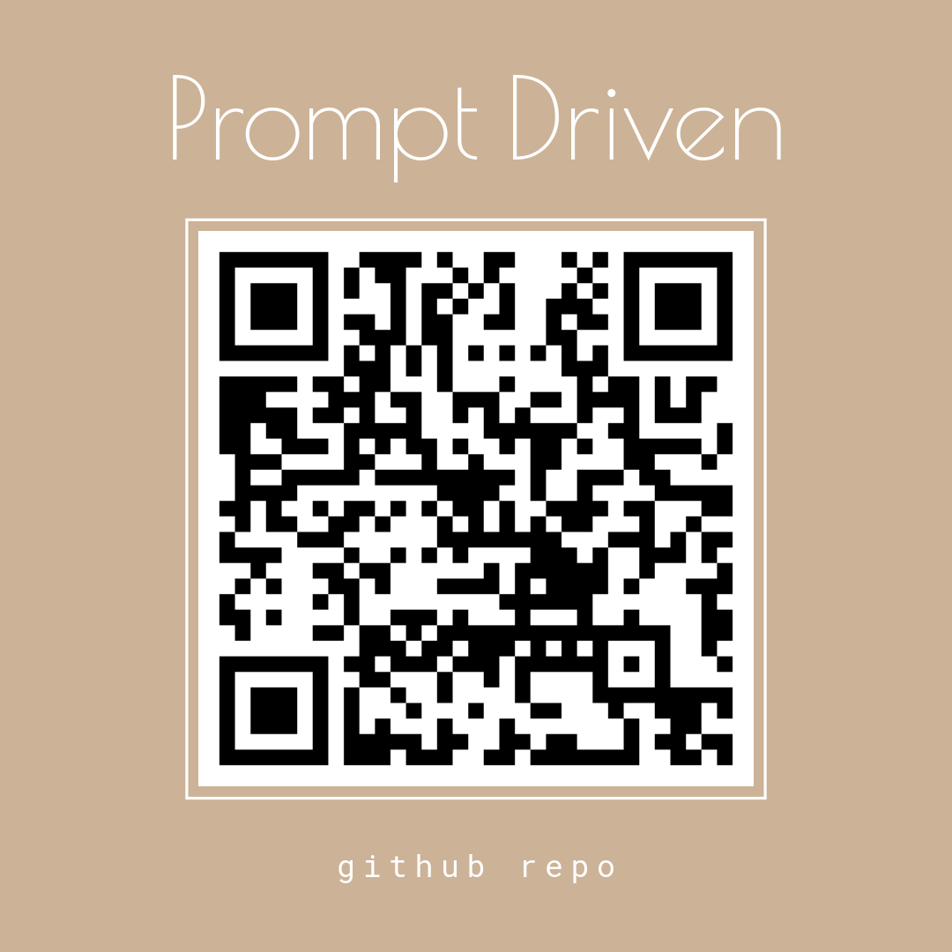

Thank You
Greg Tanaka
uv tool install pdd-cli
linkedin.com/in/gltanaka
Founder, PromptDriven.AI
glt@promptdriven.ai
Questions?

